Slide 1


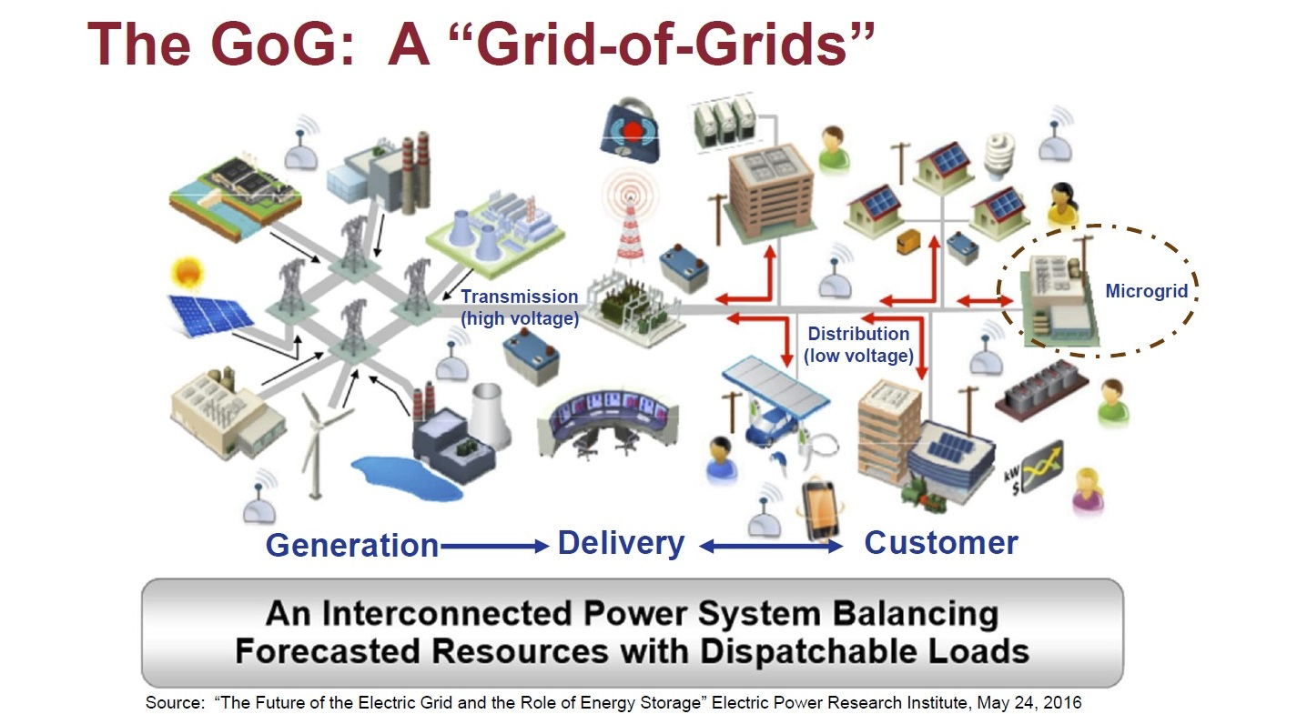
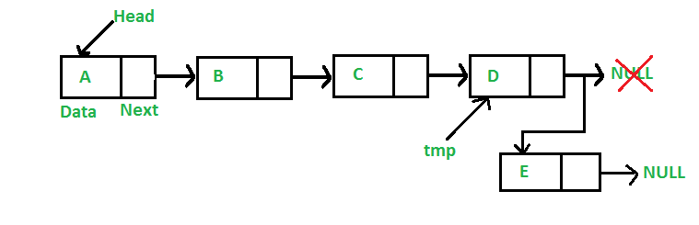
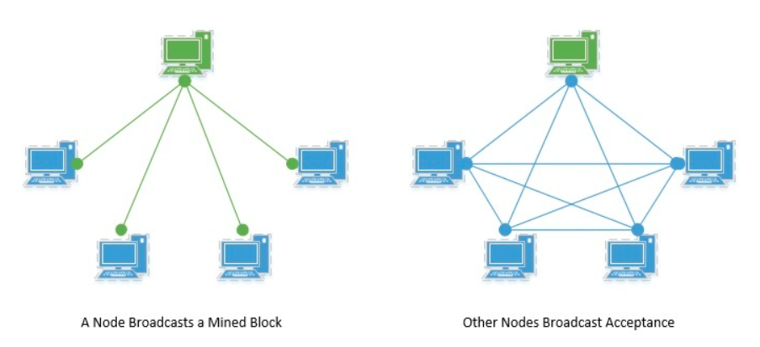




Securing U.S. Energy Infrastructure through Principles of Blockchain
Sharmila Nimbkar, Gursharan Singh, Rishik Kolli
US power grid loses about 6 trillion dollars annually to cyber attacks
Foreign energy interference is a national security threat
Sustain crucial infrastructure
Ensure stable economy
Problem
Solution
Implemented and housed in all the computers at facility
Encrypts all data sent between devices or facilities
Sensor sends information gathered and verifies/accepts information
Prevents an attacker from getting network access or admin privileges
Decentralized system with every communication recorded communally and verified with a majority vote by the devices
Extends to multiple devices to create huge encrypted network
Customers
1) Secure data from hackers
2) Allow secure access
3) Real-time analysis of suspicious data
4) Alerting mechanism that can notify.
plant users
Stakeholders
U.S. Department of Energy (Primary)
Private Energy Utilities (Primary)
State Energy Management Companies (Primary)
US National Security Agencies
Environmental Protection Agency
Societal Challenges
Raise in consumer energy prices affecting low-income households
Cybersecurity expenses
Expenses of changing the structure of all energy networks and implementing blockchain resources in the computer networks
Coordination between government, Dept of Energy, Dept of Defense, and private energy utilities
Technology
Blockchain: method of data collection and security that is nearly impossible to tamper with or decrypt without a key
- Smart Grid: implementation of the Internet of Things into power saving or energy management devices
References
M. Mith“Advantages or Disadvantages of the Greenhouse Effect”, The Medium. Jan 31, 2019
S. Battaglia, “US Now Leads in Energy Waste”, Energy Central. Mar 3, 2013.
Center for Climate and Energy Solutions, “Renewable Energy” 2019.
International Monetary Federation, “The Evidence that Growth Creates Jobs: A New Look at an Old Relationship” November 9, 2016.

Slide 5

References
M. Mith“Advantages or Disadvantages of the Greenhouse Effect”, The Medium. Jan 31, 2019
S. Battaglia, “US Now Leads in Energy Waste”, Energy Central. Mar 3, 2013.
Center for Climate and Energy Solutions, “Renewable Energy” 2019.
International Monetary Federation, “The Evidence that Growth Creates Jobs: A New Look at an Old Relationship” November 9, 2016.

